Slide 1
FEASIBILITY ANALYSIS -RU HUNGRY!-
SYSTEM ANALYSIS AND DESIGN LAB
PROJECT
RU HUNGRY

Slide 2
Our Team
Kazi Sidratul Muntaha
Md. Zunayed Rahman
Rashedur Rahman
Md Sunmon Hossain Siam
S.M. Ifran Nizum
Aminul Islam
RU HUNGRY!

Slide 3
SURVEY ATTENDEE STATISTICS
Total Participants: 26
Occupation:
76.9%
19.2%
3.8%
Student
Others
Businessman
RU HUNGRY!

Slide 4
SURVEY ATTENDEE STATISTICS
Gender
Age
Male
Female
15-20 Y OLD
30+ Y OLD
73.1%
26.9%
11.5%
7.7%
0%
80.8%
Prefer Not To say
20-30 Y OLD
RU HUNGRY!

Slide 5
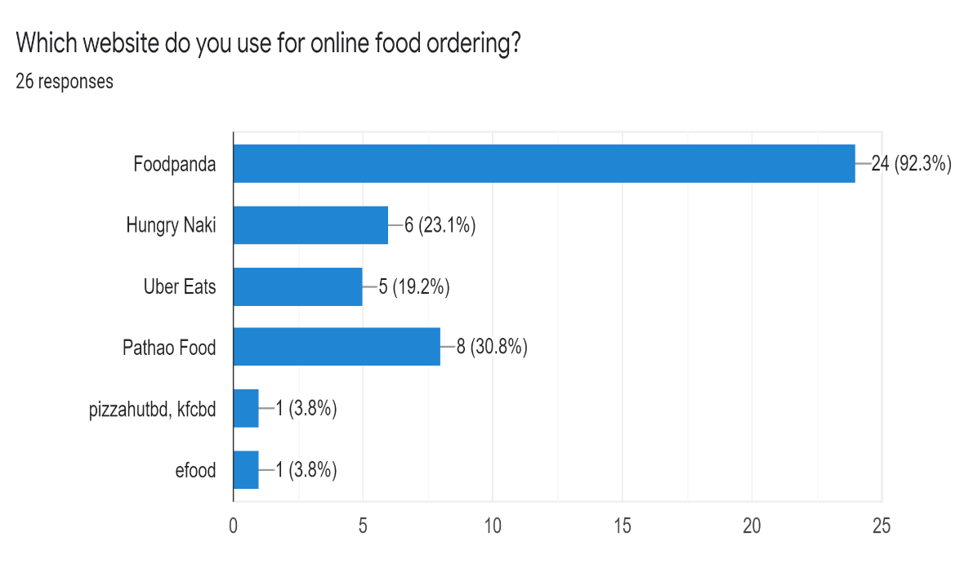
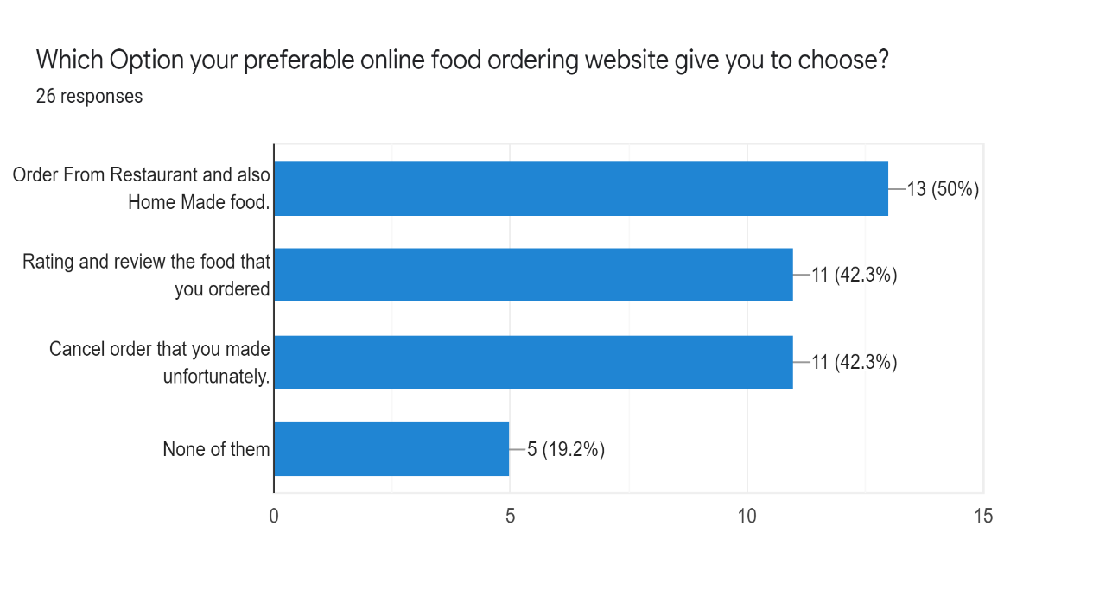
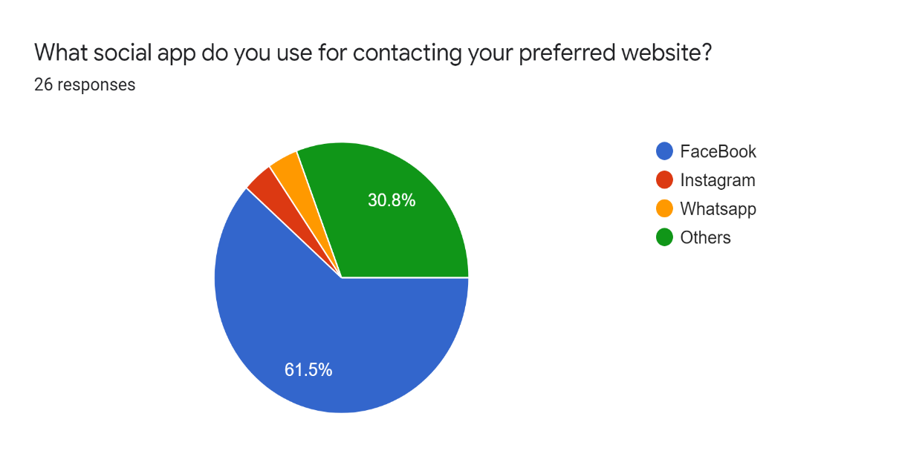
FeedBack
FeedBack
RU HUNGRY!

Slide 6
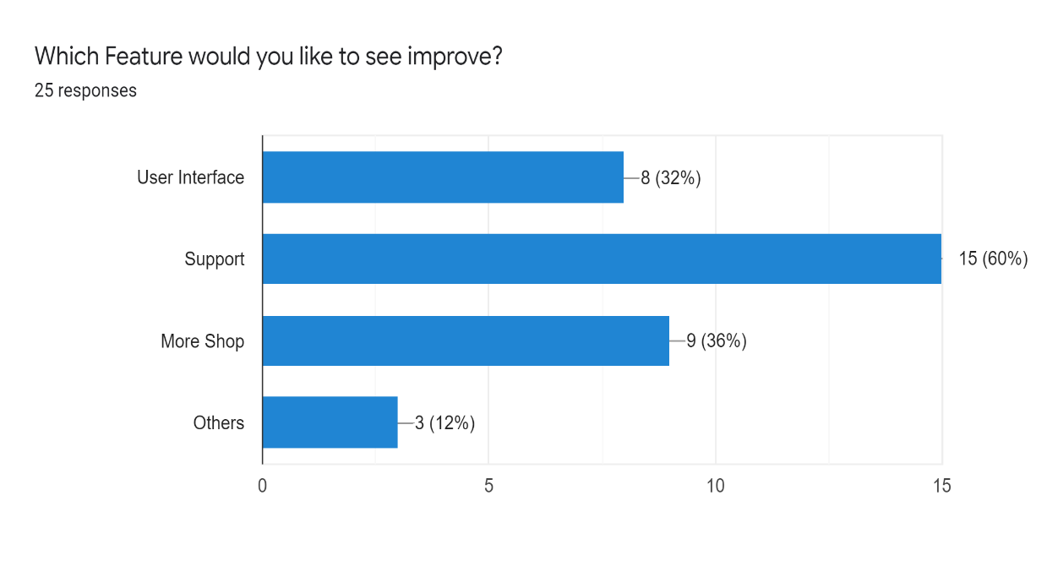
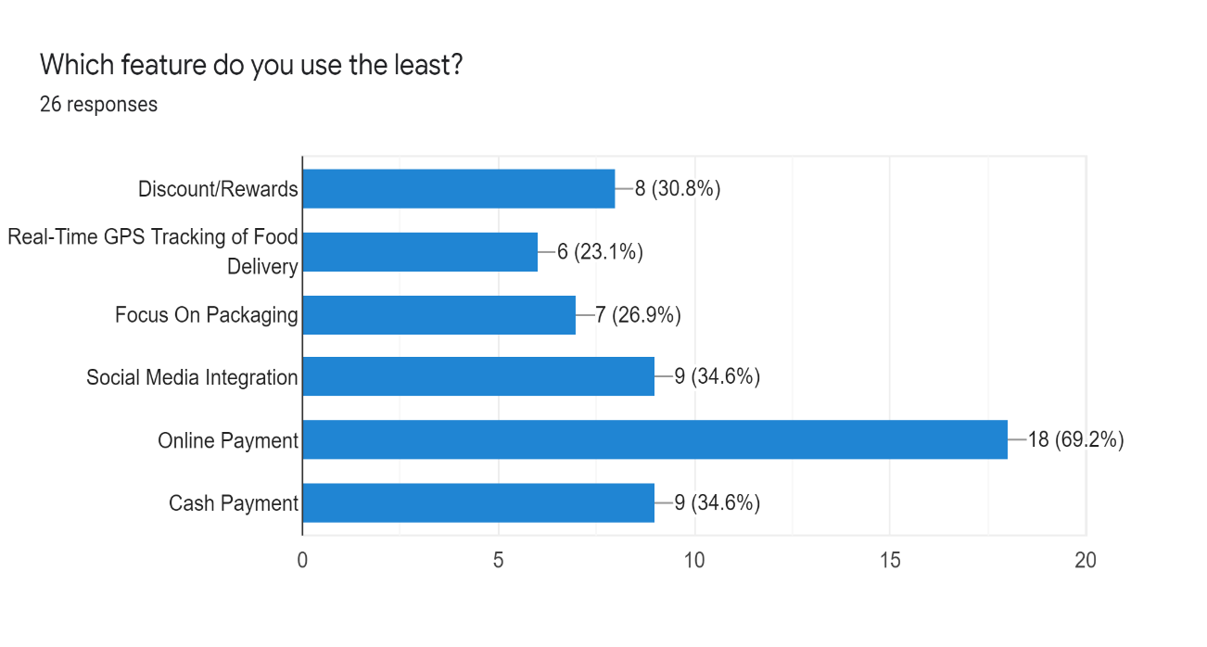
FeedBack
RU HUNGRY!

Slide 7
FeedBack
Response Questions | EXTREMELY NEEDED | PERFECT | OKAY | OF COURSE | NOT THAT USEFUL
IF YOU CAN ORDER FROM BOTH RESTAURANT AND HOMEMADE FOOD FROM ONE PLATRFORM, THEN WHAT DO YOU THINK ABOUT IT? | 50% | 38.5% | 11.5% |  | 0%
IF YOU CAN BOTH RATE AND REVIEW THE SPECIFIC FOOD THAT YOU HAVE ORDERED. DO YOU THINK THIS FEATURE WILL BE HELPFUL? |  |  |  | 100% | 0%
IF YOU CAN SEE THE RATING AND THE REVIEW FOR EVERY FOOD FROM EVERY RESTAURANT THEN WOULD IT BE MORE HELPFUL FOR YOU TO MAKE DECISION? |  |  |  | 100% | 0%
IF YOU UNFORTUNATELY PLACED AN ORDER, YOU CAN ALSO CANCEL THE ORDER WITHIN A FEW SECONDS. THEN WHAT DO YOU THINK ABOUT THIS? | 73.1% | 26.9% |  |  | 0%
Green = Maximum Audience Red= Least Audience Gray= Option Not Available for that question
*PowerPoint SmartArt graphic

Slide 8
Features:
Login / Signup
Admin Panel
User Can Choose
Review and Rating on every food
Order History
Cancel Order
Cart
Blog
Wishlist
Payment
Coupon
RU HUNGRY

Slide 9
S.W.O.T Analysis
STRENGTH
WEAKNESS
S
W
Free
Have Unique Features
Grab All types of Customers
Limited Features
Lack Of Financial Backup
O
T
OPPORTUNITYY
THREAT
Better Rank
Improve User Experience
Popularity Of other similar websites
Security issue
RU HUNGRY

Slide 10
THANK YOU
RU HUNGRY

